Slide 1

SILVER OAK COLLEGE OF COMPUTER APPLICATION
SUBJECT :Programming in Python
TOPIC : Python Flow control , Loops & Strings

Slide 2


Conditional Statements
In daily routine
If it is very hot, I will skip exercise.
If there is a quiz tomorrow, I will first study and then sleep. Otherwise I will sleep now.
If I have to buy coffee, I will go left. Else I will go straight.

Slide 3
if-else statement
Compare two integers and print the min.
if x < y:
print (x)
else:
print (y)
print (‘is the minimum’)
Check if x is less than y.
If so, print x
Otherwise, print y.

Slide 4
Indentation
Indentation is important in Python
grouping of statement (block of statements)
no explicit brackets, e.g. { }, to group statements
x,y = 6,10
if x < y:
print (x)
else:
print (y)
print (‘is the min’)
Run the program
x
y
6
10
skipped
Output
6

Slide 5
if statement (no else!)
General form of the if statement
Execution of if statement
First the expression is evaluated.
If it evaluates to a true value, then S1 is executed and then control moves to the S2.
If expression evaluates to false, then control moves to the S2 directly.
if boolean-expr :
S1
S2
true
false
S1
S2

Slide 6
if-else statement
General form of the if-else statement
Execution of if-else statement
First the expression is evaluated.
If it evaluates to a true value, then S1 is executed and then control moves to S3.
If expression evaluates to false, then S2 is executed and then control moves to S3.
S1/S2 can be blocks of statements!
if boolean-expr :
S1
else:
S2
S3
true
false
S1
S2
S3

Slide 7
Nested if, if-else
if a <= b:
if a <= c:
…
else:
…
else:
if b <= c) :
…
else:
…

Slide 8
Elif
A special kind of nesting is the chain of if-else-if-else-… statements
Can be written elegantly using if-elif-..-else
if cond1:
s1
else:
if cond2:
s2
else:
if cond3:
s3
else:
…
if cond1:
s1
elif cond2:
s2
elif cond3:
s3
elif …
else
last-block-of-stmt

Slide 9
Summary of if, if-else
if-else, nested if's, elif.
Multiple ways to solve a problem
issues of readability, maintainability
and efficiency

Slide 10
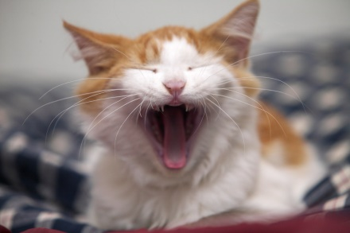
Class Quiz
What is the value of expression:
Run time crash/error
I don’t know / I don’t care
False
True
(5<2) and (3/0 > 1)
The correct answer is
False

Slide 11
Short-circuit Evaluation
Do not evaluate the second operand of binary short-circuit logical operator if the result can be deduced from the first operand
Also applies to nested logical operators
not( (2>5) and (3/0 > 1) ) or (4/0 < 2)
Evaluates to true
true
false
false
true

Slide 12
3 Factors for Expr Evaluation
Precedence
Applied to two different class of operators
+ and *, - and *, and and or, …
Associativity
Applied to operators of same class
* and *, + and -, * and /, …
Order
Precedence and associativity identify the operands for each operator
Not which operand is evaluated first
Python evaluates expressions from left to right
While evaluating an assignment, the right-hand side is evaluated before the left-hand side.
Notes:
NOTE: add example to show the effect of order of evaluation

Slide 13
Class Quiz
What is the output of the following program:
y = 0.1*3
if y != 0.3:
print ('Launch a Missile')
else:
print ("Let's have peace")
Launch a Missile

Slide 14
Caution about Using Floats
Representation of real numbers in a computer can not be exact
Computers have limited memory to store data
Between any two distinct real numbers, there are infinitely many real numbers.
On a typical machine running Python, there are 53 bits of precision available for a Python float

Slide 15
Caution about Using Floats
The value stored internally for the decimal number 0.1 is the binary fraction
Equivalent to decimal value
Approximation is similar to decimal approximation 1/3 = 0.333333333...
No matter how many digits you use, you have an approximation
0.00011001100110011001100110011001100110011001100110011010
0.1000000000000000055511151231257827021181583404541015625

Slide 16
Comparing Floats
Because of the approximations, comparison of floats is not exact.
Solution?
Instead of
x == y
use
abs(x-y) <= epsilon
where epsilon is a suitably chosen small value

Slide 17

Programming using Python
Loops

Slide 18
Printing Multiplication Table
5 | X | 1 | = | 5
5 | X | 2 | = | 10
5 | X | 3 | = | 15
5 | X | 4 | = | 20
5 | X | 5 | = | 25
5 | X | 6 | = | 30
5 | X | 7 | = | 35
5 | X | 8 | = | 40
5 | X | 9 | = | 45
5 | X | 10 | = | 50

Slide 19
Program…
n = int(input('Enter a number: '))
print (n, 'X', 1, '=', n*1)
print (n, 'X', 2, '=', n*2)
print (n, 'X', 3, '=', n*3)
print (n, 'X', 4, '=', n*4)
print (n, 'X', 5, '=', n*5)
print (n, 'X', 6, '=', n*6)
….
Too much
repetition!
Can I avoid
it?

Slide 20
Printing Multiplication Table
Loop Entry
Input n
i = 1
Loop Exit
i <=10
TRUE
FALSE
Print n X i = n*i
i = i+1
Stop
Loop

Slide 21
Printing Multiplication Table
Input n
i = 1
n = int(input('n=? '))
i = 1
while (i <= 10) :
print (n ,'X', i, '=', n*i)
i = i + 1
print ('done‘)
TRUE
i <=10
FALSE
Print n x i = ni
i = i+1
Stop

Slide 22
While Statement
while (expression):
S1
S2
FALSE
expression
TRUE
S1
S2
Evaluate expression
If TRUE then
execute statement1
goto step 1.
If FALSE then execute statement2.

Slide 23
For Loop
Print the sum of the reciprocals of the first 100 natural numbers.
rsum=0.0# the reciprocal sum
# the for loop
for i in range(1,101):
rsum = rsum + 1.0/i
print ('sum is', rsum)

Slide 24
For loop in Python
General form
for variable in sequence:
stmt

Slide 25
range
range(s, e, d)
generates the list:
[s, s+d, s+2*d, …, s+k*d]
where s+k*d < e <= s+(k+1)*d
range(s, e) is equivalent to range(s, e, 1)
range(e) is equivalent to range(0, e)
Exercise: What if d is negative? Use python interpreter to find out.

Slide 26
Quiz
What will be the output of the following program
# print all odd numbers < 10
i = 1
while i <= 10:
if i%2==0: # even
continue
print (i, end=‘ ‘)
i = i+1

Slide 27
Continue and Update Expr
Make sure continue does not bypass update-expression for while loops
# print all odd numbers < 10
i = 1
while i <= 10:
if i%2==0: # even
continue
print (i, end=‘ ‘)
i = i+1
i is not incremented
when even number
encountered.
Infinite loop!!

Slide 28
Strings
Strings in Python have type str
They represent sequence of characters
Python does not have a type corresponding to character.
Strings are enclosed in single quotes(') or double quotes(“)
Both are equivalent
Backslash (\) is used to escape quotes and special characters

Slide 29
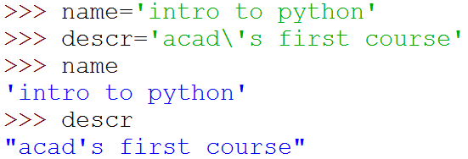

Strings
More readable when print is used

Slide 30
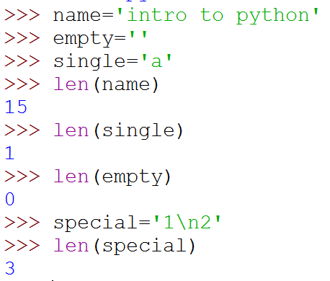
Length of a String
len function gives the length of a string
\n is a single character: the special character representing newline

Slide 31
Concatenate and Repeat
In Python, + and * operations have special meaning when operating on strings
+ is used for concatenation of (two) strings
* is used to repeat a string, an int number of time
Function/Operator Overloading

Slide 32

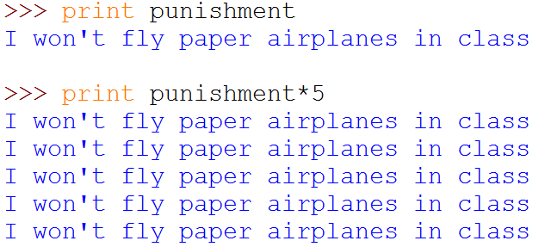
Concatenate and Repeat

Slide 33
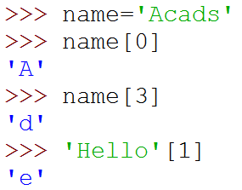
Indexing
Strings can be indexed
First character has index 0

Slide 34
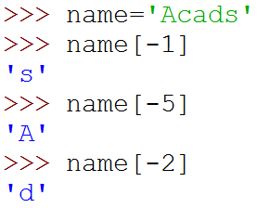
Indexing
Negative indices start counting from the right
Negatives indices start from -1
-1 means last, -2 second last, ...

Slide 35
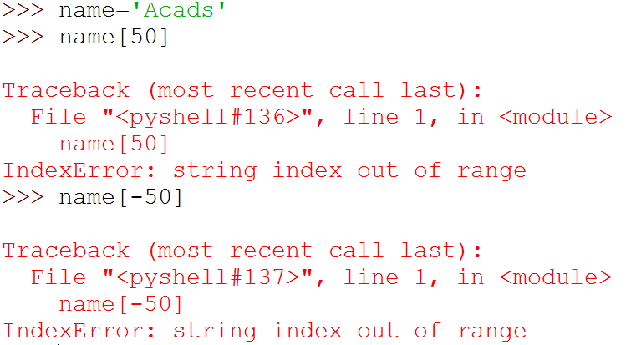
Indexing
Using an index that is too large or too small results in “index out of range” error

Slide 36
Slicing
To obtain a substring
s[start:end] means substring of s starting at index start and ending at index end-1
s[0:len(s)] is same as s
Both start and end are optional
If start is omitted, it defaults to 0
If end is omitted, it defaults to the length of string
s[:] is same as s[0:len(s)], that is same as s

Slide 37
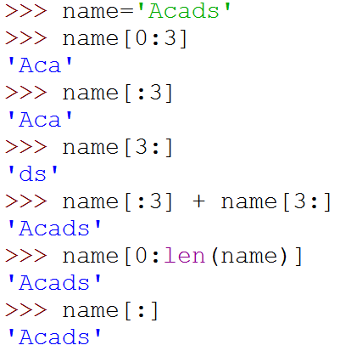
Slicing

Slide 38
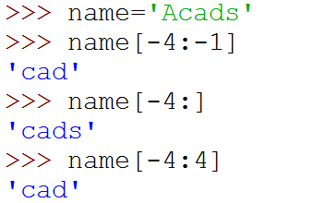
More Slicing
Understanding Indices for slicing
A | c | a | d | s
0 | 1 | 2 | 3 | 4
-5 | -4 | -3 | -2 | -1
5

Slide 39
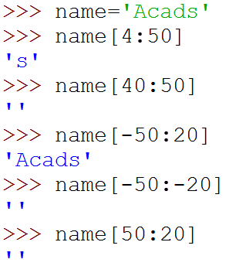

Out of Range Slicing
A | c | a | d | s
0 | 1 | 2 | 3 | 4
-5 | -4 | -3 | -2 | -1
Out of range indices are ignored for slicing
when start and end have the same sign, if start >=end, empty slice is returned
Why?

